Slide 1
Design of Spur Gears

Slide 2
Gears
Gears are toothed, cylindrical wheels used for transmitting motion and power from one rotating shaft to another.
Most gear drives cause a change in the speed of the output gear relative to the input gear.
Some of the most common types of gears are spur gears, helical gears, bevel gears, and worm/wormgear sets.

Slide 3
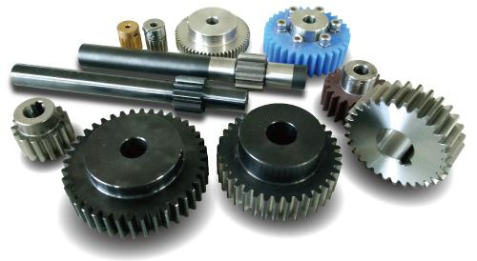
Spur Gears
Spur gears have teeth that are straight and arranged parallel to the axis of the shaft that carries the gear.
The curved shape of the faces of the spur gear teeth have a special geometry called an involute curve.
Note: The shafts
carrying the gears are parallel.

Slide 4
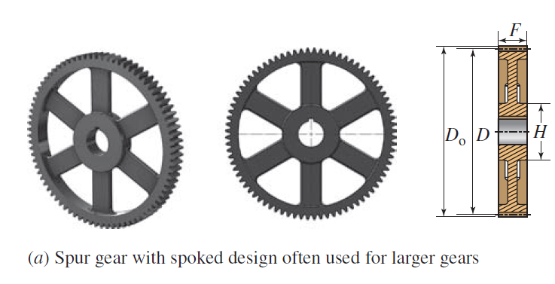
Spur Gears
When gears are large, the spoked design in Part (a) is often used to save weight. The gear teeth are machined into a relatively thin rim that is held by a set of spokes connecting to the hub.

Slide 5
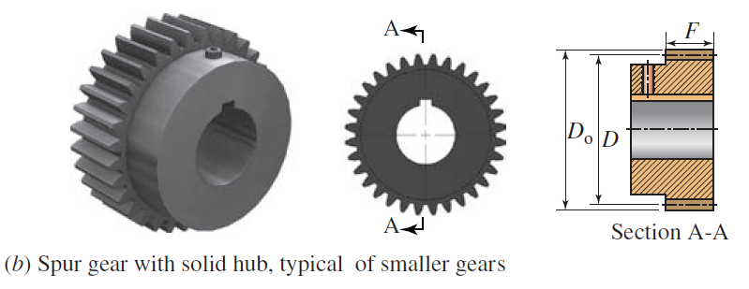
Spur Gears
The solid hub design is typical of smaller spur gears. Here the finished bore with a keyway is visible.
The set screw over the keyway allows the locking of the key in place after assembly.

Slide 6
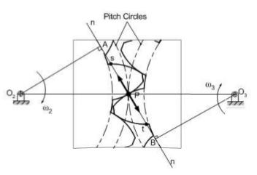
Law of Gearing
It is a fundamental principle of kinematics, the study of motion, that if the line drawn perpendicular to the surfaces of two rotating bodies at their point of contact always crosses the centerline between the two bodies at the same place, the angular velocity ratio of the two bodies will be constant. This is a statement of the law of gearing

Slide 7
Gear Involute Profile Meshing
When two such gear teeth are in mesh and rotating, there is a constant angular velocity ratio between them
From the moment of initial contact to the moment of disengagement, the speed of the driving gear is in a constant proportion to the speed of the driven gear.
The resulting action of the two gears is very smooth.
If this were not the case, there would be some speeding up and slowing down during the engagement, with the resulting accelerations causing vibration, noise, and dangerous torsional oscillations in the system.

Slide 8
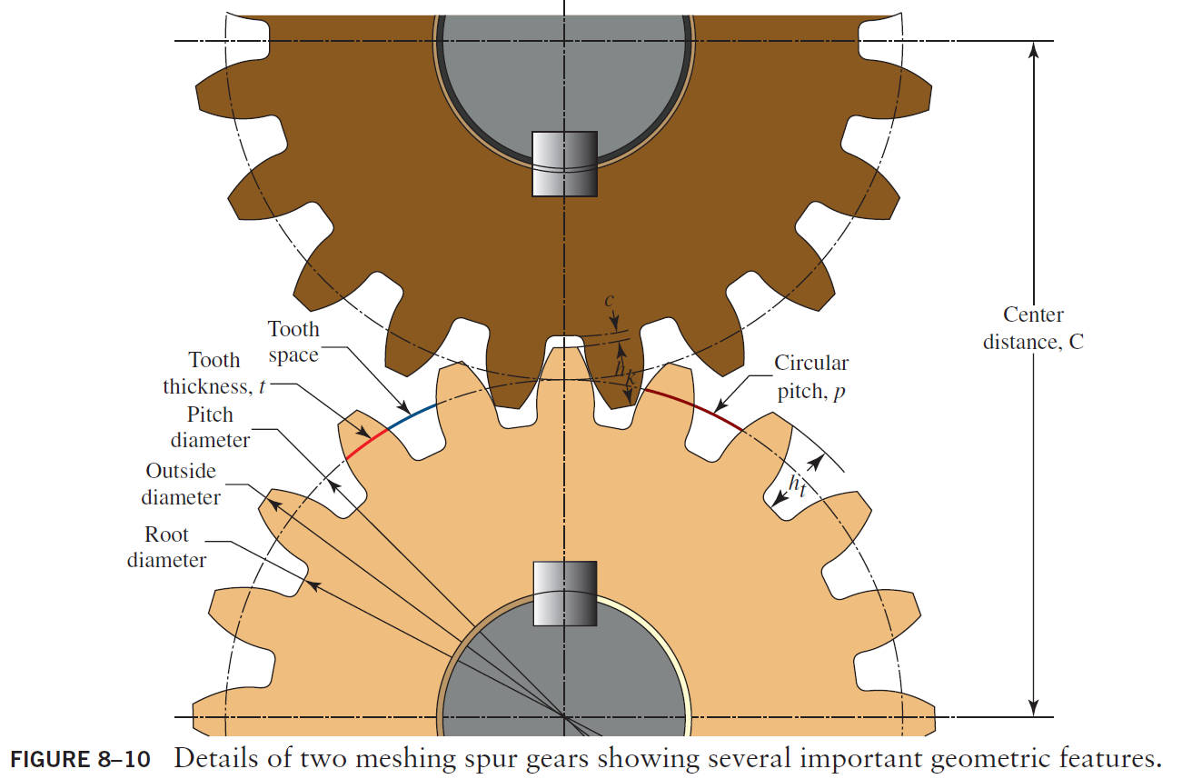

Slide 9
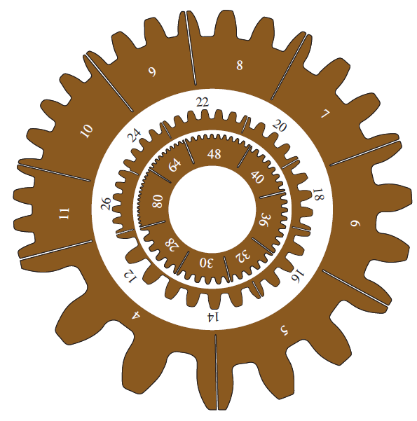
Spur Gears
Gear-tooth size as a function of diametral pitch—actual size

Slide 10
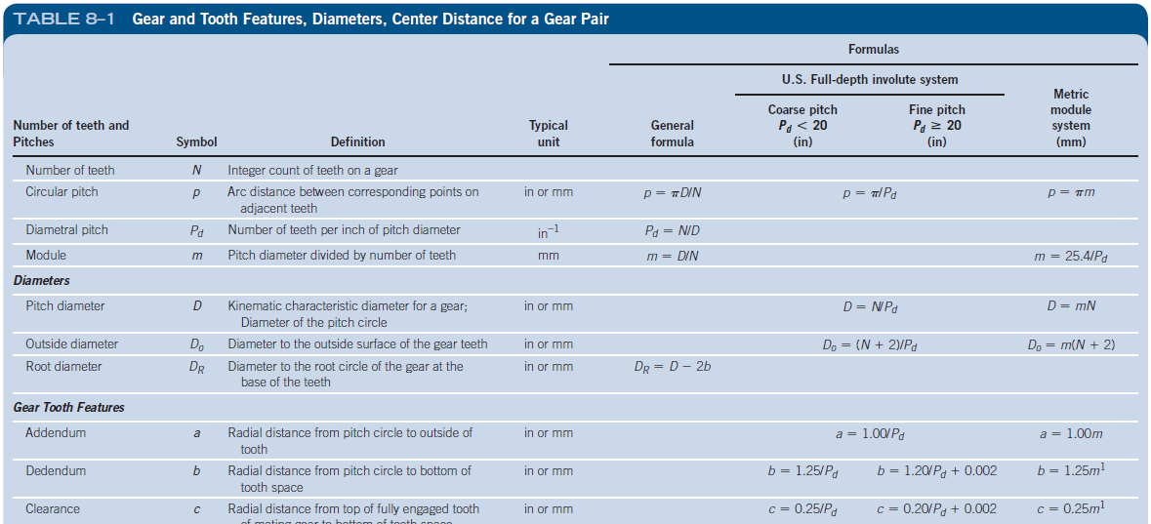
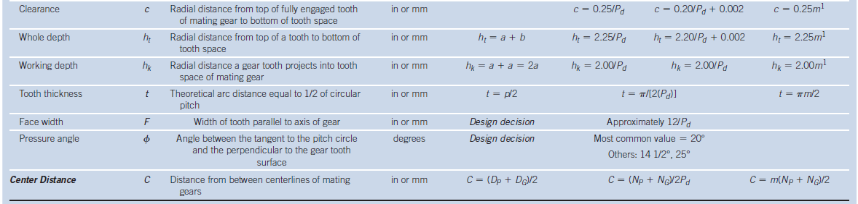
Spur Gears
When gears are large, the spoked design in Part (a) is often used to save weight. The gear teeth are machined into a relatively thin rim that is held by a set of spokes connecting to the hub.

Slide 11
Interference Between Mating Spur Gear Teeth
For certain combinations of numbers of teeth in a gear pair, there is interference between the tip of the teeth on the pinion and the fillet or root of the teeth on the gear.
The probability that interference will occur is greatest when a small pinion drives a large gear, with the worst case being a small pinion driving a rack.
A rack is a gear with a straight pitch line; it can be thought of as a gear with an infinite pitch diameter

Slide 12
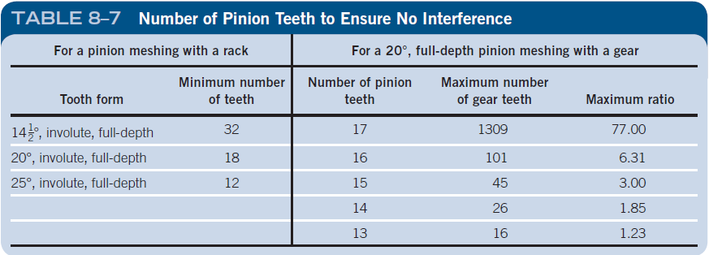
Interference Between Mating Spur Gear Teeth
It is the designer’s responsibility to ensure that interference does not occur in a given application.
The surest way to do this is to control the minimum number of teeth in the pinion to the limiting values

Slide 13
Goal of the Chapter
Design spur gears to transmit power from a source such as an electric motor, gasoline engine, fluid power motor, turbine, or other prime mover to a driven machine while changing the speed of the input shaft to some other speed at the output shaft.
Most gear-type power transmissions are speed reducers that deliver the power to the driven machine at a lower speed and a higher torque.
Examples of such transmissions are:
Electric motor drives through the transmission to a conveyor in a factory.
Gasoline engine for a vehicle drives through the transmission to the drive wheels.
Fluid power motor drives through the transmission to a winch on a tractor.

Slide 14
4. Water turbine drives through the transmission to an electric generator.
5. Gas turbine (jet) engine drives through the transmission to the rotor of a helicopter.
Although more rare than speed reducers, transmissions may also be used as speed increasers.
An important example is a wind turbine that rotates relative slowly, say 20.0 rpm, and the speed must be increased to 1800 rpm to drive an electric generator.

Slide 15
You are the Designer
You have already made the design decision that a spur gear type of speed reducer is to be used for a particular application. How do you complete the design of the gears themselves?
You, as the designer, required to deal with the kinematics of a gear reducer that would take power from the shaft of an electric motor rotating at 1750 rpm and deliver it to a machine that was to operate at approximately 292 rpm.

Slide 16
There you have limited your interest to the decisions that affected motion and the basic geometry of gears.
It was decided to use a double reduction gear train to reduce the speed of rotation of the drive system in two stages using two pairs of gears in series.
You have also learned how to specify the layout of the gear train, along with key design decisions such as the numbers of teeth in all of the gears and the relationships among the diametral pitch, the number of teeth in the gears, the pitch diameters, and the distance between the centers of the shafts that carry those gears.
For a chosen diametral pitch, you learned how to compute the dimensions of key features of the gear teeth such as the addendum, dedendum, and tooth width.

Slide 17
But the design is not complete until you have specified
Material from which the gears are to be made
Until you have verified that the gears will withstand the forces exerted on the gears as they transmit power and the corresponding torque.
The teeth must not break, and they must have a sufficiently long life to meet the needs of the customer who uses the reducer.

Slide 18
To complete the design, you need more data:
How much power is to be transmitted?
To what kind of machine is the power from the output of the reducer being delivered?
How does that affect the design of the gears?
What is the anticipated duty cycle for the reducer in terms of the number of hours per day, days per week, and years of life expected?
What options do you have for materials that are suitable for gears?
Which material will you specify, and what will be its heat treatment?

Slide 19
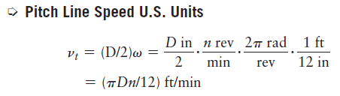
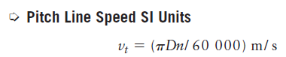
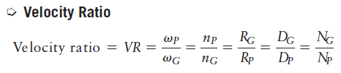
Pitch line speed

Slide 20
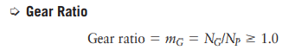
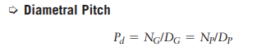
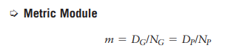

Slide 21
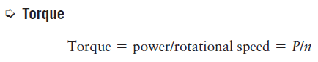
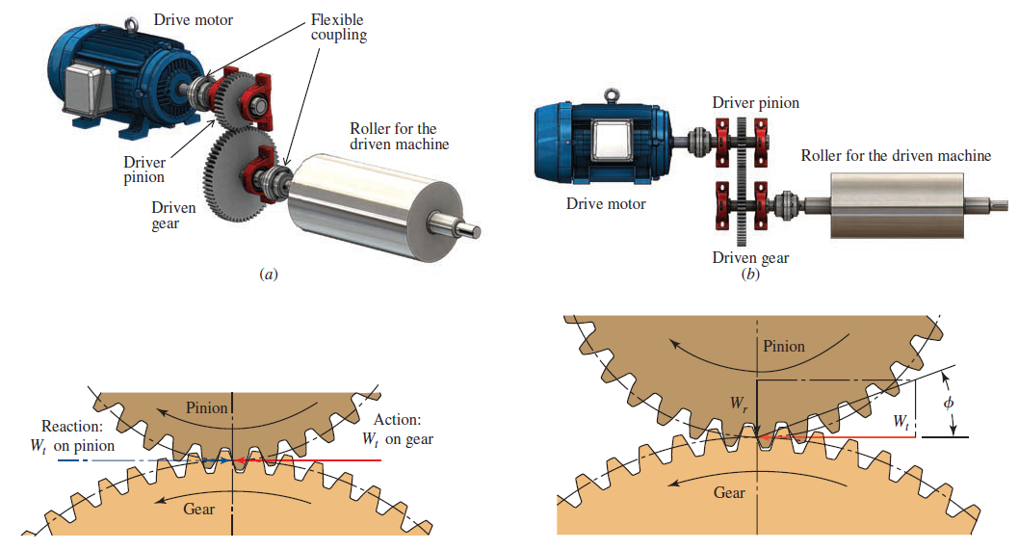
Forces, Torque and Power

Slide 22
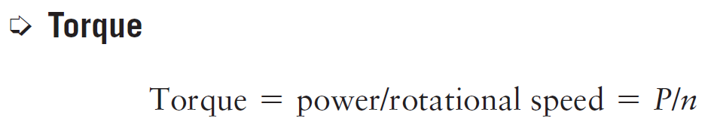
Torque
It is important to determine the torque in both the input and output shafts using the following equation:
The power is transmitted from the input shaft to the pinion through a key. The teeth of the pinion drive the teeth of the gear and thus transmit the power to the gear.

Slide 23
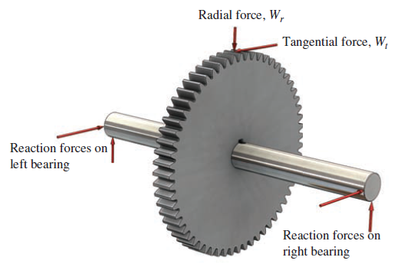
Torque

Slide 24
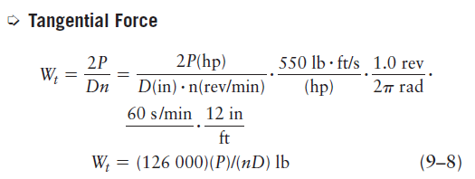
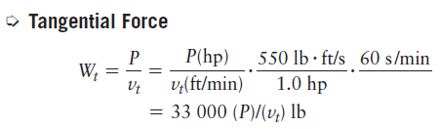
Tangential Force

Slide 25
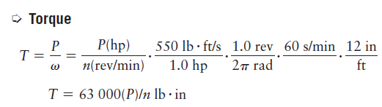
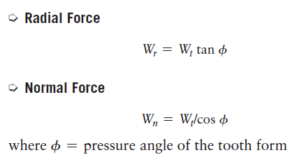
Torque and Forces

Slide 26
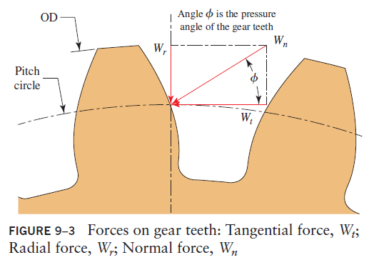
Power Flow and Efficiency
Power losses in gear drives made from spur, helical, and bevel gears depend on the action of each tooth on its mating tooth, a combination of rolling and sliding.

Slide 27
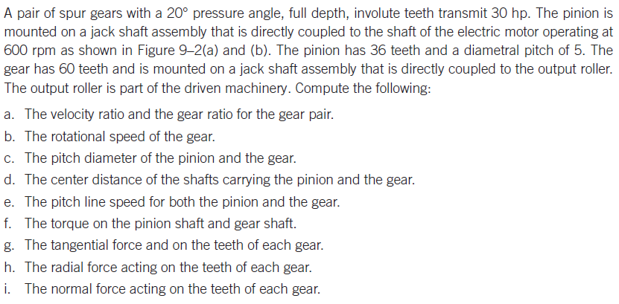
Example Problem

Slide 28
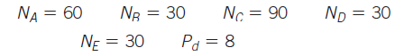
Example Problem
Gear A is mounted on an electric motor that has a rotational speed of 1500 rpm (CW). Gear A drives a simple gear train consisting of gears B, C, D, and E. Gear A transfers the input power through each gear to the shaft on which it is mounted. The power levels delivered from shafts B, C, D, and E are 3 hp, 8 hp, 3 hp, and 3 hp, respectively. All gears have a diametral pitch of 10 and the following numbers of teeth:

Slide 29
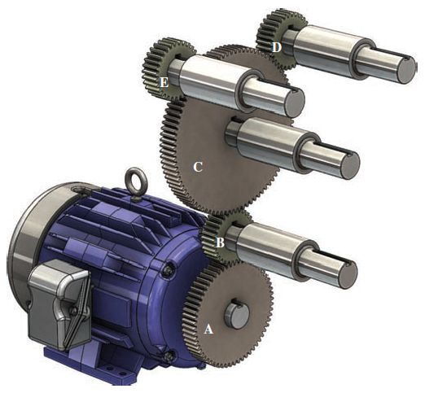
Gears
Determine the following data for the drive system:
a. The pitch diameter of each gear
b. The center distance of each gear mesh
c. The rotational speed of each output shaft
d. Neglecting efficiency losses, find the power requirement of the electric motor
e. The torque through each output shaft and the tangential force on the gear teeth

Slide 30
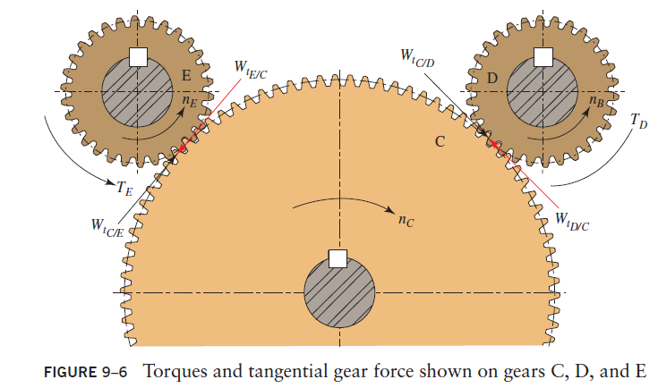

Slide 31
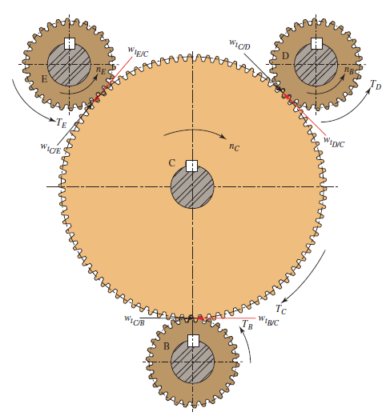

Slide 32
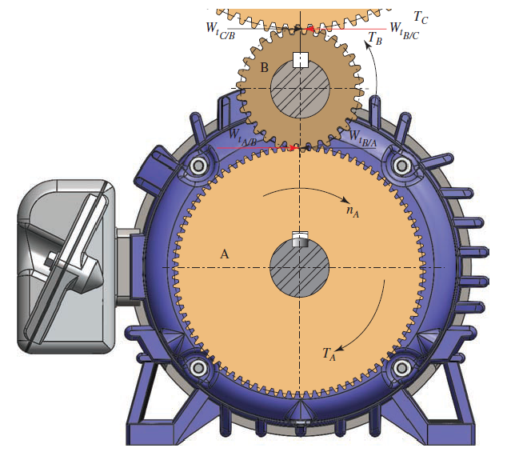

Slide 33
Stress Analysis for Gears
Two forms of gear-tooth failure are considered:
A gear tooth acts like a cantilever beam in resisting the force exerted on it by the mating tooth. The point of highest tensile bending stress is at the root of the tooth where the involute curve blends with the fillet.
A second, independent form of failure is the pitting of the surface of the teeth, usually near the pitch line, where high contact stresses occur.
The transfer of force from the driving to the driven tooth theoretically occurs across a line contact because of the action of two convex curves on each other.
Repeated application of these high contact stresses can cause a type of fatigue failure of the surface, resulting in local fractures and an actual loss of material.

Slide 34
Stress Analysis for Gears
The AGMA has developed a set of allowable bending stress numbers, called sat, which are compared to computed bending stress levels in the tooth to rate the acceptability of a design.
The AGMA has developed a set of allowable contact stress numbers, called sac, which are compared to computed contact stress levels in the tooth to rate the acceptability of a design.

Slide 35
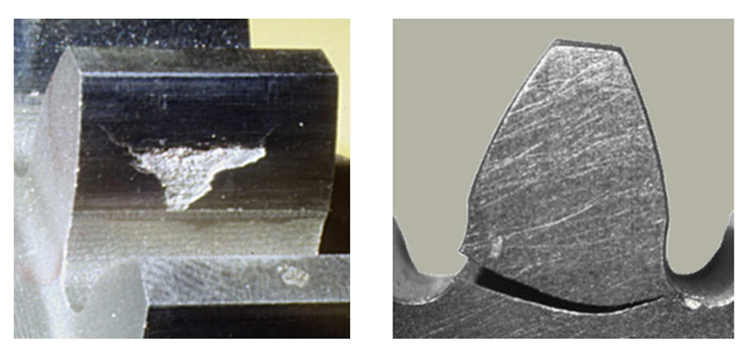
Failure in Gears
Both bending stress and contact stress must be at safe levels in any pair of gears.

Slide 36
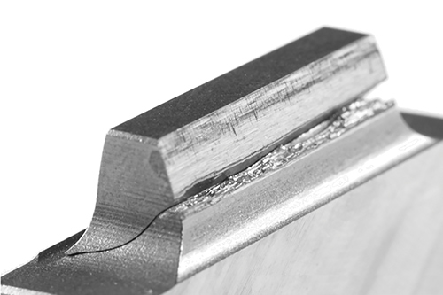
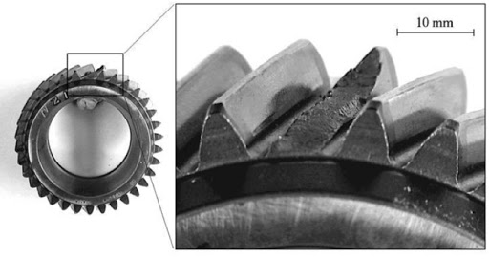
Failure in Gears

Slide 37
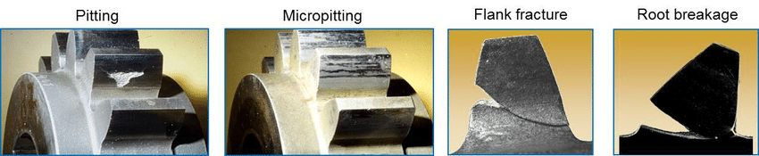
The stress analysis of gear teeth is facilitated by consideration of the orthogonal force components, W_{t} and W_{r}.
The tangential force, W_{t}, produces a bending moment on the gear tooth similar to that on a cantilever beam.
The resulting bending stress is maximum at the base of the tooth in the fillet that joins the involute profile to the bottom of the tooth space.

Slide 38
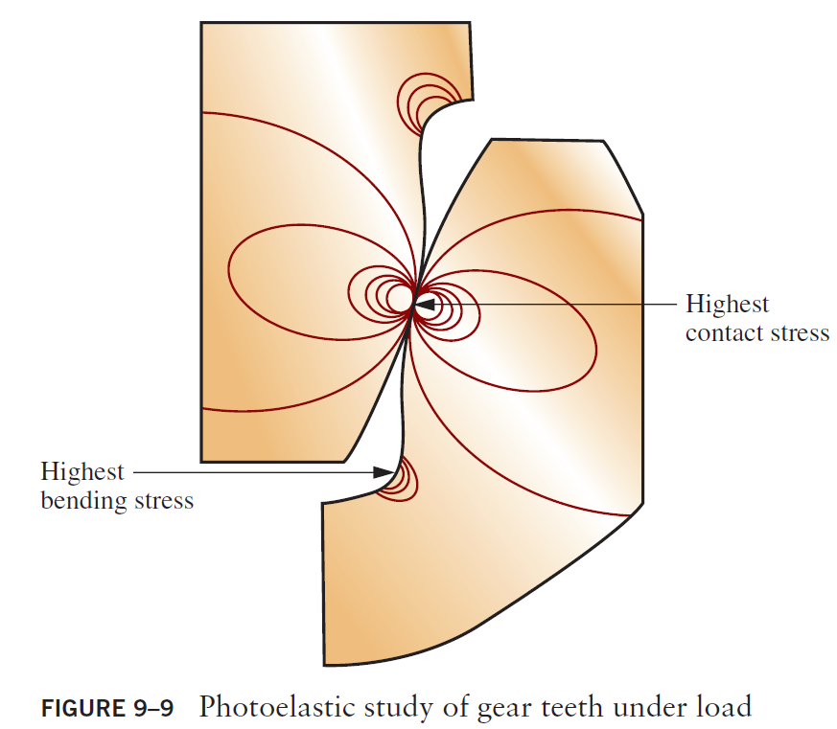

Slide 39
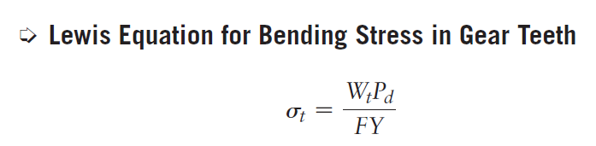
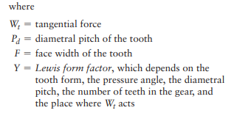
Lewis Equation for Stress on Gear Tooth
Taking the detailed geometry of the tooth into account, Wilfred Lewis developed the equation for the stress at the base of the involute profile, which is now called the Lewis equation:
While the theoretical basis for the stress analysis of gear teeth is presented, the Lewis equation must be modified for practical design and analysis.

Slide 40
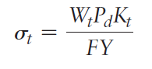
Modified Lewis Equation
Comparing the actual stress at the root with that predicted by the Lewis equation enables us to determine the stress concentration factor, K_{t}, for the fillet area.
The value of the stress concentration factor is dependent on the form of the tooth, the shape and size of the fillet at the root of the tooth, and the point of application of the force on the tooth.

Slide 41
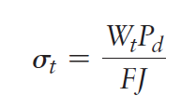
Modified Lewis Equation
Lewis form factor, Y, also depends on the tooth geometry. Therefore, the two factors are combined into one term, the geometry factor, J, where J = Y/K_{t}.
Using the geometry factor, J, in the stress equation gives

Slide 42
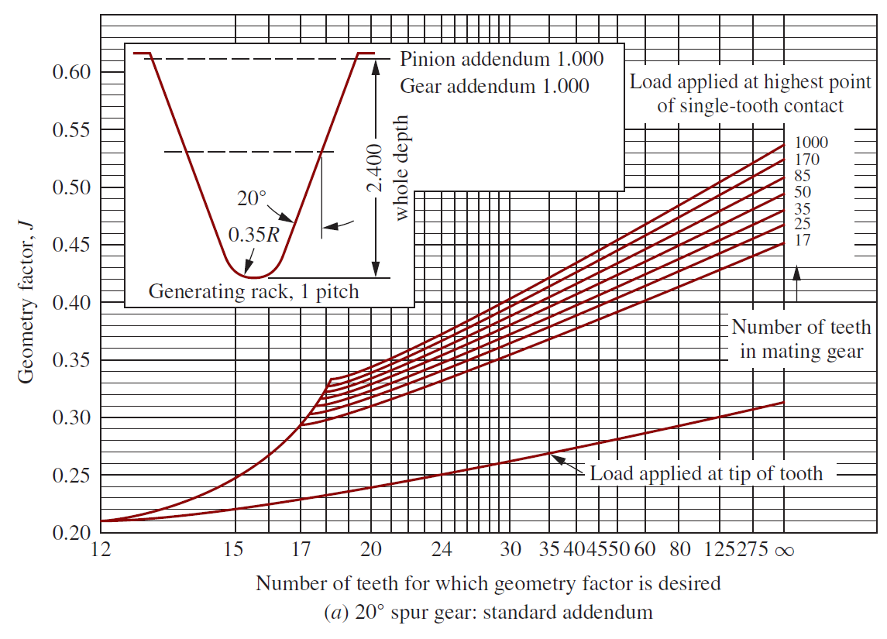
Geometry Factor (J) (Fig. 9-10a)

Slide 43
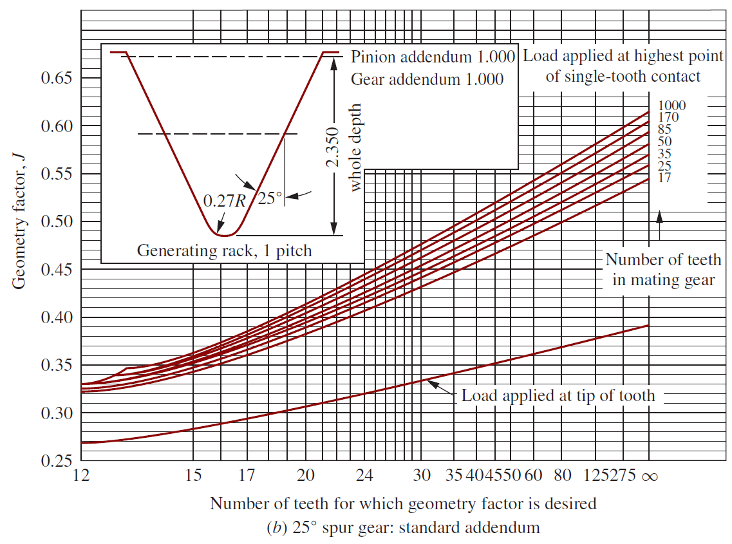
Geometry Factor (J) (Fig. 9-10b)

Slide 44
Bending Stress Number (s_{t})
The approach used by the AGMA is to apply a series of additional modifying factors to the bending stress from the modified Lewis equation to compute a value called the bending stress number, s_{t}.
These factors represent the degree to which the actual loading case differs from the theoretical basis of the Lewis equation.

Slide 45
Allowable Bending Stress Number
Then, separately, the allowable bending stress number, s_{at}, is modified by a series of factors that affect that value when the environment is different from the nominal situation assumed when the values for s_{at} are set.
The result here is a better estimate of the real level of the bending strength of the material from which the gear or the pinion is made.

Slide 46
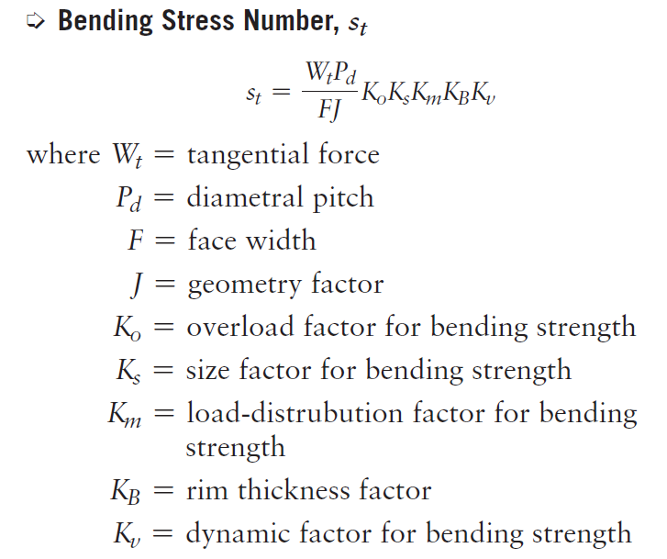
Bending Stress Number (s_{t})

Slide 47
Diametral Pitch, P_{d}
The diametral pitch is the size of the gear tooth and is related to the number of teeth and the pitch diameter.
If the diametral pitch is not given as a specific value in a problem, use Figure 9–11 to select a trial value.
Steel that is through hardened to HB 300 is used to generate the graph.
Because of the numerous variables involved, the value of P_{d} read from the figure is only an initial target value.

Slide 48
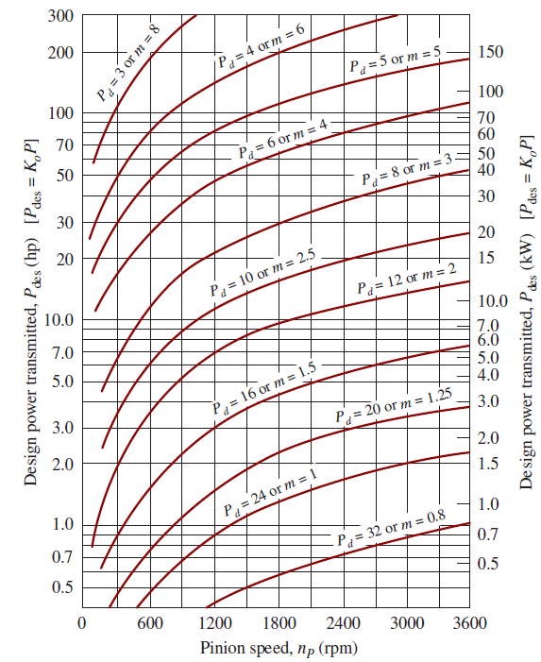
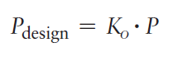
Diametral Pitch, P_{d}
The design power equation is:
Ko is the overload factor.
P is the power being transmitted by the gear pair
P_{design} is the power level used for the design of the gear drive system

Slide 49
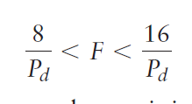
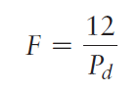
Face Width, F
The face width of the gear tooth should fall within this range:
The upper limit given tends to minimize alignment problems and ensures reasonable loading across the face.
the nominal face width value can be calculated using:

Slide 50
Geometry Factor, J
Figure 9–10(a) and (b) are used to select the geometry factor, based on the pressure angle and the number of teeth of the meshing gear set.

Slide 51
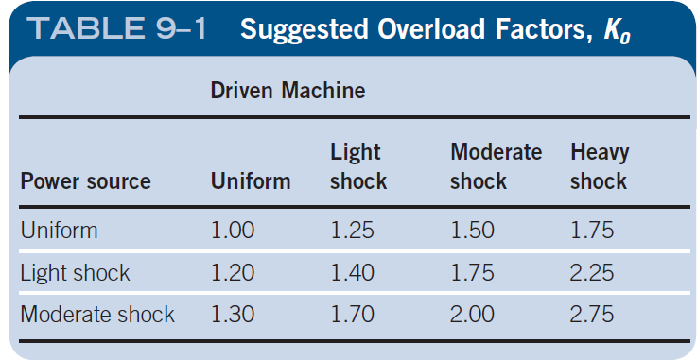
Overload Factor, K_{o}
Overload factors consider the probability that load variations, vibrations, shock, speed changes, and other application-specific conditions may result in peak loads greater than W_{t} being applied to the gear teeth during operation.

Slide 52
Overload Factor, K_{o}
Power Sources:
Uniform: Electric motor or constant-speed gas turbine
Light shock: Water turbine, variable-speed drive
Moderate shock: Multicylinder engine.
Driven machines
Uniform: Continuous-duty generator, paper, and film winders.
Light shock: Fans and low-speed centrifugal pumps, liquid agitators, variable-duty generators, etc
Moderate shock: High-speed centrifugal pumps, reciprocating pumps and compressors, etc.
Heavy shock: Rock crushers, punch press drives, pulverizers, processing mills, tumbling barrels, wood chippers,

Slide 53
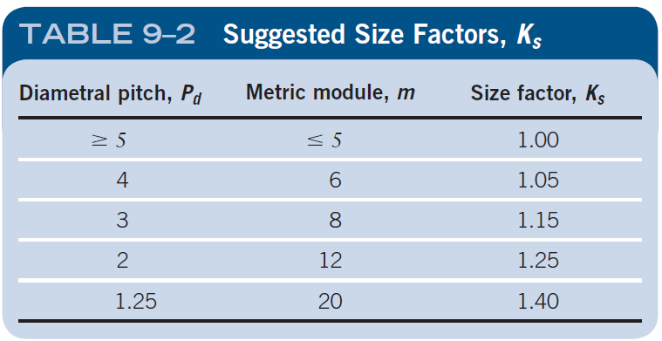
Size Factor, Ks
The AGMA indicates that the size factor can be taken to be 1.00 for most gears. But for gears with large-size teeth or large face widths, a value greater than 1.00 is recommended.

Slide 54
Load-Distribution Factor, Km
The determination of the load-distribution factor is based on many variables in the design of the gears themselves as well as in the shafts, bearings, housings, and the structure in which the gear drive is installed.
Any of the following factors can cause misalignment of the teeth on the pinion relative to those on the gear:
Inaccurate gear teeth.
Misalignment of the axes of shafts carrying gears.
Elastic deformations of the gears, shafts, bearings, housings, and support structures.
Clearances between the shafts and the gears, the shafts and the bearings, or the bearings and the housing.
Thermal distortions during operation.
Crowning or end relief of gear teeth

Slide 55
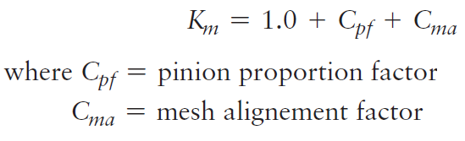
Load-Distribution Factor, Km
We will use the following equation for computing the value of the load-distribution factor:

Slide 56
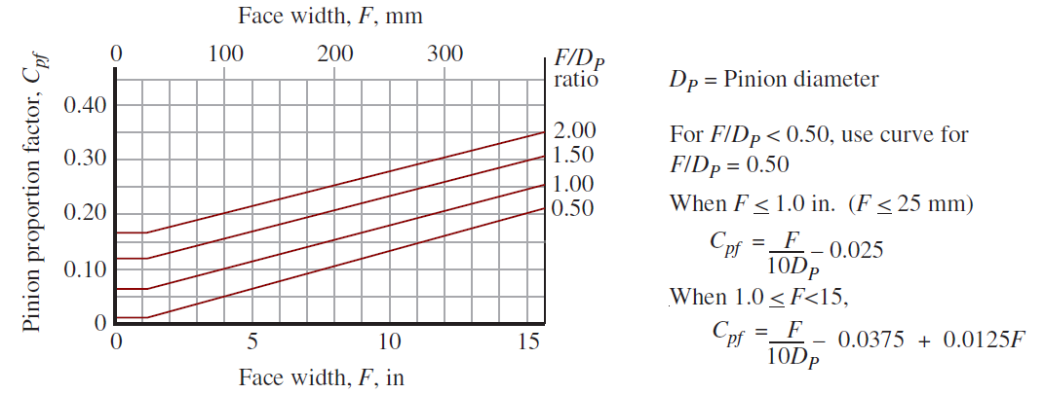
Pinion proportion factor, C_{pf}

Slide 57

Mesh alignment factor, C_{ma}

Slide 58
Mesh alignment factor, C_{ma}
Open gearing refers to drive systems in which the shafts are supported in bearings that are mounted on structural elements of the machine with the expectation that relatively large misalignments will result.
In commercial-quality enclosed gear units, the bearings are mounted in a specially designed housing that provides more rigidity than for open gearing, but for which the tolerances on individual dimensions are fairly loose.
Precision enclosed gear units are made to tighter tolerances.
Extra-precision enclosed gear units are made to exacting precision and are often adjusted at assembly to achieve excellent alignment of the gear teeth.

Slide 59

Rim Thickness Factor, K_{B}

Slide 60

Rim Thickness Factor, K_{B}
The key geometry parameter is called the backup ratio, m_{B}, where

Slide 61
Dynamic Factor, K_{v}
The dynamic factor accounts for the fact that the load is assumed by a tooth with some degree of impact and that the actual load subjected to the tooth is higher than the transmitted load alone.
The value of K_{v} depends on the accuracy of the tooth profile, the elastic properties of the tooth, and the speed with which the teeth come into contact.
These factors are quantified by the use of quality numbers.

Slide 62

Standards for Gear Quality
Manufacturers, designers, and users of gears must agree on standards used to determine the acceptability of gears produced.
The current AGMA standard 2015-1-A01 employs 10 accuracy grades from A2 (most precise) to A11 (least precise).

Slide 63

Standards for Gear Quality

Slide 64

Recommended Quality Numbers

Slide 65

Graphs for Dynamic Factor, K_{v}(US units)

Slide 66

Graphs for Dynamic Factor, K_{v}(SI units)

Slide 67

Equations for Dynamic Factor, K_{v}
It is recommended that an analytical method be used when performing several designs.

Slide 68
Example Problem
Compute the bending stress numbers for the pinion and gear of the pair of gears similar to the pair shown in The pinion rotates at 1750 rpm, driven directly by an electrical motor.
The driven machine is an industrial saw requiring 25 hp. The gear unit is enclosed and is made to commercial standards. Gears are straddle mounted between bearings. The following gear data apply:
Np = 20 Ng = 70 Av = 10
The gear teeth are 20°, full depth, involute teeth and the gear blanks are solid. The gears will be made from steel

Slide 69


